Slide 1


INSTITUTE OF AERONAUTCAL ENGINEERING
Dundigal – Hyderabad
Computer Science Engineering
Title :Detecting malicious COVID-19 URLs using machine learning techniques
20951A0540
g.glory

Slide 2

OUTLINE
Abstract
Algorithm
Proposed Solution
Architecture
Keywords
Requirement Analysis
Conclusion

Slide 3

ABSTRACT
Throughout the COVID-19 outbreak, malicious attacks have become more pervasive and damaging than ever. Malicious intruders have been responsible for most of the cybercrimes committed recently and are the cause for a growing number of cyber threats, including identity and IP thefts, financial crimes, and cyber-attacks to critical infrastructures.
Machine learning (ML) has proven itself as a prominent field of study over the past decade due to solving highly complex and sophisticated real world problems. We proposes an ML-based classification technique to detect the growing number of malicious URLs, due to the COVID-19 pandemic, which is currently considered a threat to IT users.

Slide 4
ABSTRACT
We have used a large volume of Open Source data and preprocessed it using our developed tool to generate feature vectors and trained the ML model using an apprehensive malicious threat weight. Our ML model has been tested, with and without entropy to forecast the threatening factors of COVID 19 URLs. The empirical evidence proves our methods to be a promising mechanism to mitigate COVID-19 related threats early in the attack lifecycle.

Slide 5

ALGORITHM
Naive Bayes : The Naive Bayes approach is a supervised learning method which is based on a simplistic hypothesis: it assumes that the presence (or absence) of a particular feature of a class is unrelated to the presence (or absence) of any other feature .Yet, despite this, it appears robust and efficient. Its performance is comparable to other supervised learning techniques.
SVM : “Support Vector Machine” is a supervised machine learning algorithm which can be used for both classification and regression challenges. However, it is mostly used in classification problems. In this algorithm, we plot each data item as a point in n-dimensional space (where n is number of features you have) with the value of each feature being the value of a particular coordinate. Then, we perform classification by finding the hyper-plane that differentiate the two classes very well.

Slide 6
ALGORITHM
Logistic regression Classifiers : Logistic regression analysis studies the association between a categorical dependent variable and a set of independent (explanatory) variables. The name logistic regression is used when the dependent variable has only two values, such as 0 and 1 or Yes and No. The name multinomial logistic regression is usually reserved for the case when the dependent variable has three or more unique values, such as Married, Single, Divorced, or Widowed. Although the type of data used for the dependent variable is different from that of multiple regression, the practical use of the procedure is similar.
Decision tree classifiers : Decision tree classifiers are used successfully in many diverse areas. Their most important feature is the capability of capturing descriptive decision making knowledge from the supplied data. Decision tree can be generated from training sets.

Slide 7
PROPOSED SOLUTION
To combat the influx of malicious URLs related to the coronavirus, we propose a model which detects malicious URLs related to COVID-19.
The detection of malicious URLs via the lexical features present in the hostname is a fast and low risk since navigation into the domain name is required.
Most detection models throughout literature have been designed to detect URLs from popular blacklisting sites such as Phish Tank.
However, most of the features utilized in these models are not available at the time of registration.
For example, characters such as percent (%), curly brackets (), and the equal sign (=) are commonly used by Cybercriminals to obfuscate phishing URLs but cannot be used whilst registering a domain. Our proposed model can detect malicious COVID19 URLs shortly after registration which is early in the attack lifecycle.

Slide 8
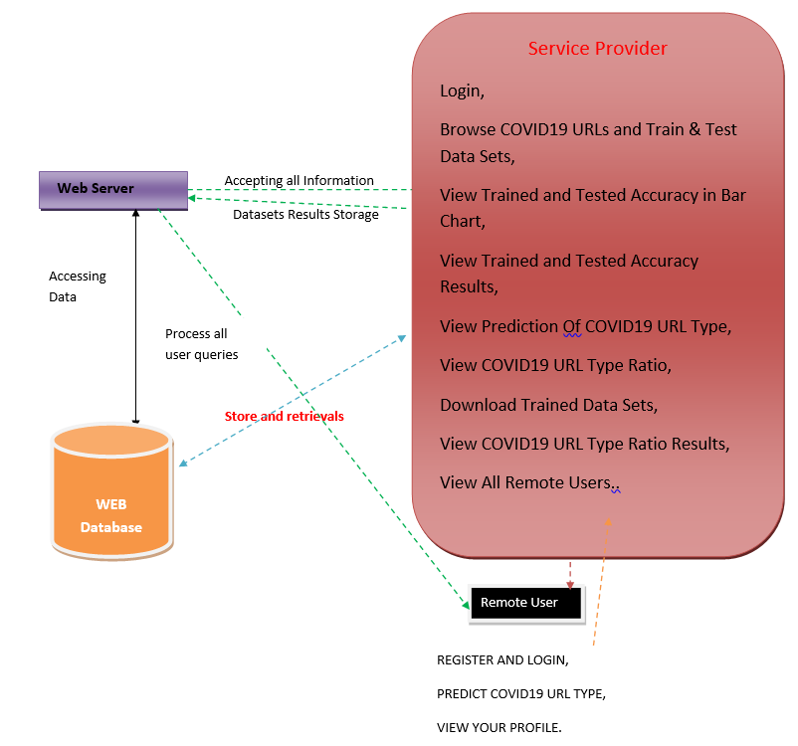
ARCHITECTURE

Slide 9
KEYWORDS
Malware
Phishing
URLs
COVID-19
Entropy
ML model
Notes:
https://www.youtube.com/watch?v=FLm3pxBtTaU
https://www.youtube.com/watch?v=CcaRfwlHyNw

Slide 10
REQUIREMENT ANALYSIS
The project involved analyzing the design of few applications so as to make the application more users friendly. To do so, it was really important to keep the navigations from one screen to the other well ordered and at the same time reducing the amount of typing the user needs to do. In order to make the application more accessible, the browser version had to be chosen so that it is compatible with most of the Browsers.
Technologies and Languages used to Develop : Python

Slide 11
REQUIREMENT SPECIFICATION
Functional Requirements :
Graphical User interface with the User.
Software Requirements :
For developing the application the following are the Software Requirements:
Python
Django
MySQL
Wamp server

Slide 12
Operating Systems supported
Windows 7
Windows XP
Windows 8
Hardware Requirements
For developing the application the following are the Hardware Requirements:
Processor: Pentium IV or higher
RAM: 256 MB
Space on Hard Disk: minimum 512MB

Slide 13
CONCLUSION
We proposed a framework to detect malicious domain names containing COVID-19 related keywords. Using only 5 features, our model detected malicious domain names with a 99.2% accuracy rate. To achieve this, we trained and tested our model using 7849 domain names from who is DS and Domain Tools.
Although the entropy of malicious domains was higher on average than benign domain names, entropy added little value to the overall accuracy rate of most algorithms except for KNN.
Overall, our model offers 722a promising solution to minimizing COVID related phishing and malware attacks by detecting malicious domain names, early in the attack lifecycle. This is due to its ability to detect malicious URLs with a high accuracy using only the domain name and a minimal number of features.

Slide 14
CONCLUSION
Future work will investigate the incongruence of entropy as a feature. Unlike other studies which successfully used entropy to improve their detection accuracy, we observed no substantial benefit in the inclusion of Shannon’s entropy to detect malicious domain names.
This could be an indication that Cybercriminals are purposely registering malicious domain names with lower entropy values to evade detection. Thus understanding these phenomena would offer a positive contribution to knowledge.

Slide 15
Thank You ☺

